Slide 1
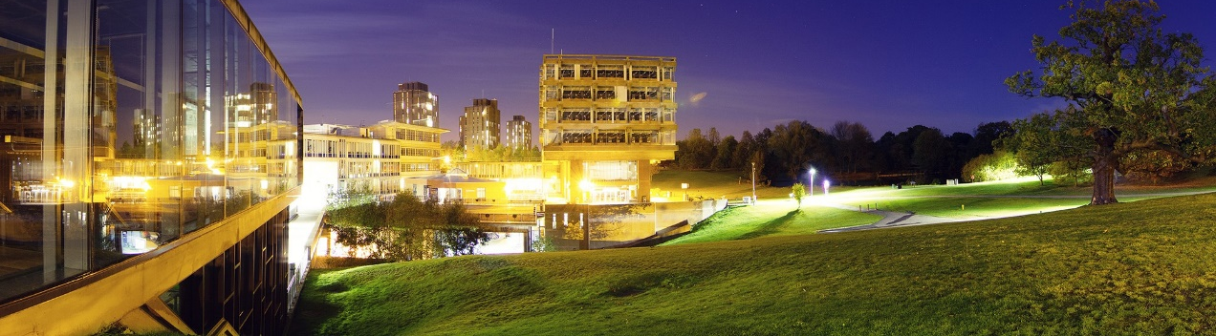


CSEE Home
Professor Richard Bartle FRSA Senior Lecturer & Honorary Professor Computer Science and Electronic Engineering rabartle@essex.ac.uk 01206 874246
Undergraduate Study
Postgraduate Study
How to Apply
Research
Overview
Publications
Research
Staff
Biography Dr Richard A. Bartle is Senior Lecturer and Honorary Professor of Computer Game Design at the University of Essex, UK. He is best known for having co-written in 1978 the first virtual world, MUD, and for his 1996 Player Types model which has seen widespread adoption by the MMO industry. His 2003 book, "Designing Virtual Worlds", is the standard text on the subject, and he is an influential writer on all aspects of MMO design and development. In 2010, he was the first recipient of the prestigious GDC "Online Game Legend" award.
Qualifications BSc Hons (1st class) Computer Science, Essex University, 1981. PhD Artificial Intelligence, Essex University, 1988
Additionally here is a blog I update daily: http://www.youhaventlived.com/qblog/index.html
About Us
Contact Us

Slide 2
Improvements made to improve Fitts’ Law results: -Increased the width and height of the vertical navigation menu icons. -Increasing the width of the vertical menu pushes the centre closer to all of them. -Increased the width and height of the horizontal navigation menu icons. -Increasing the text size should improve the result for external links and generally improve the readability of the content.

